Slide 1
RPI DORMS
Website design
By Bomy, Mei, Kenneth, and Shelly

Slide 2
Anyone here visit RPI prior to moving in?
Anyone here search for information instead?

Slide 3
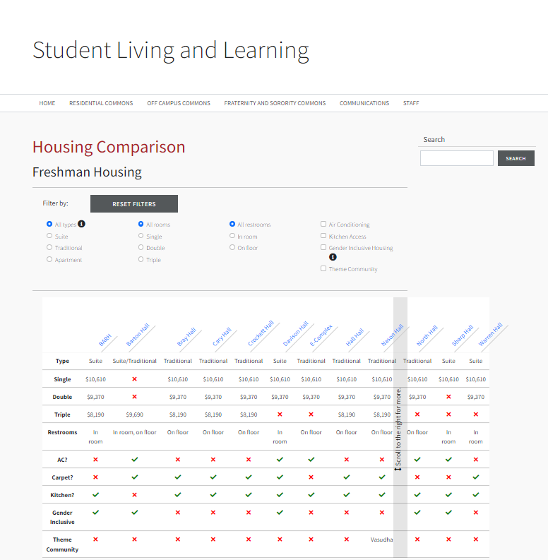
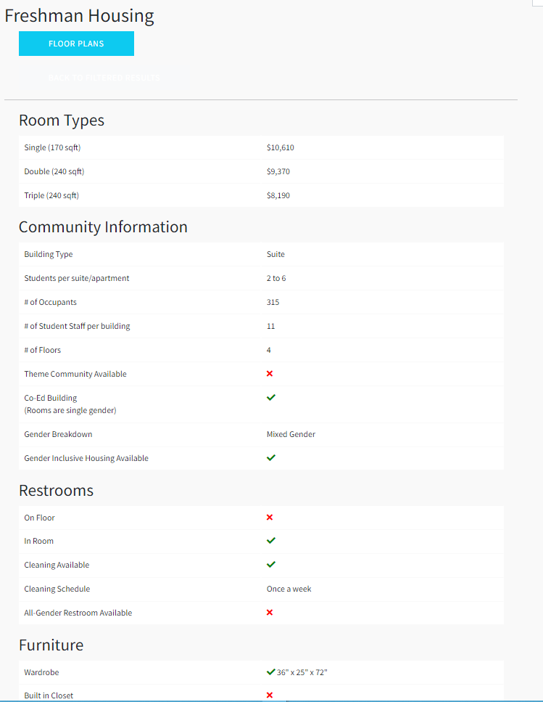
RPI’s Official Site
Us
-Their website sucks
-Its is more functional and organized

Slide 4
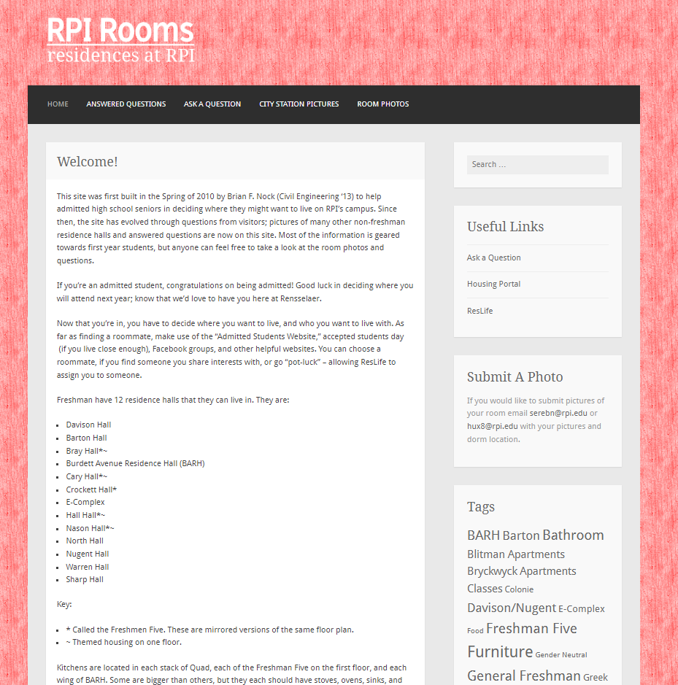
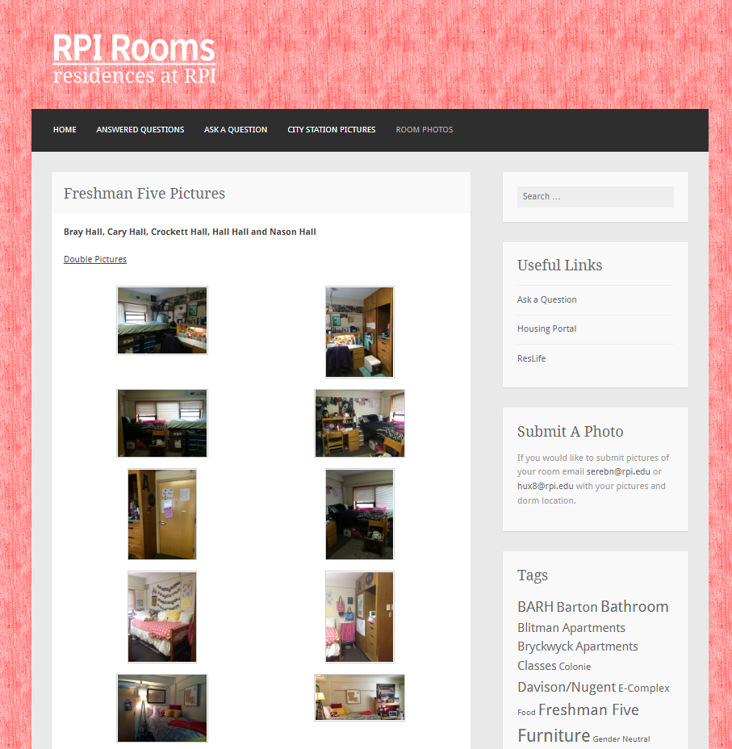
RPI Rooms
Them
Us
-Their website sucks
-Its is more functional and organized

Slide 5
RPI Dorms
Design
Students
Accessible
Better organized and designed website!
We made this project to help incoming students at RPI!
Easily accessible in one place. There’s no need to search through multiple platforms!

Slide 6
01.
About the Design

Slide 7
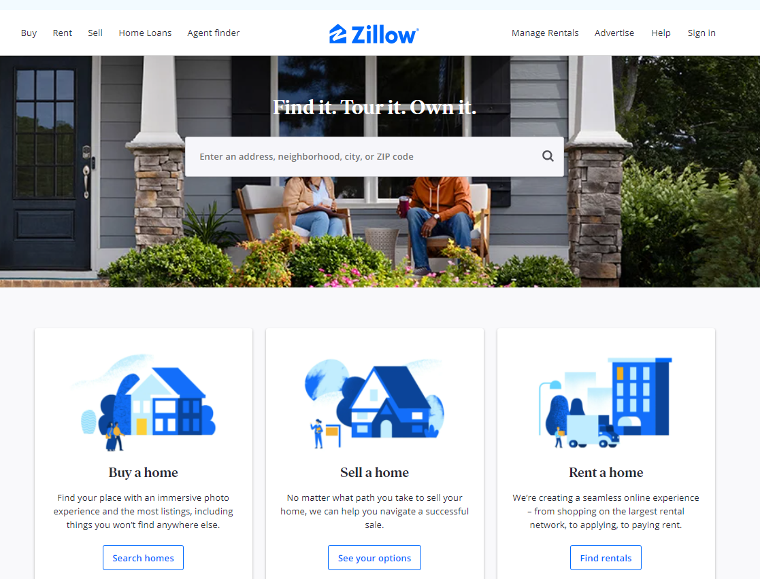
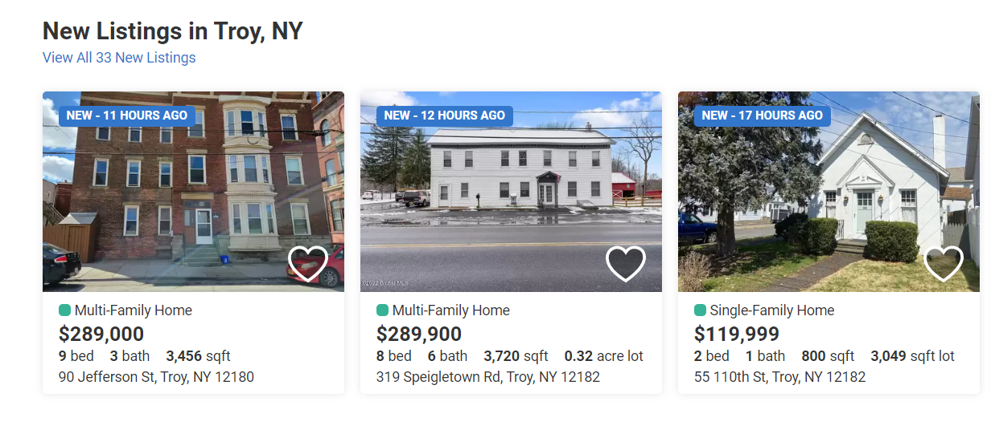
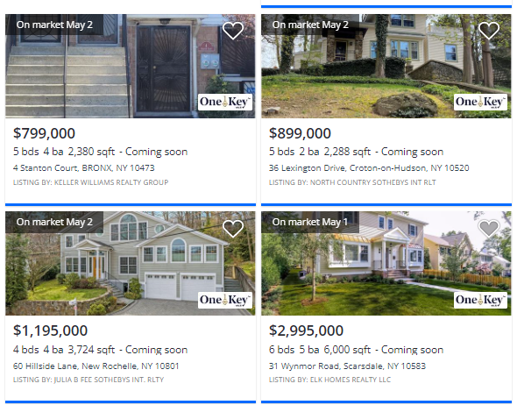
Inspiration

Slide 8
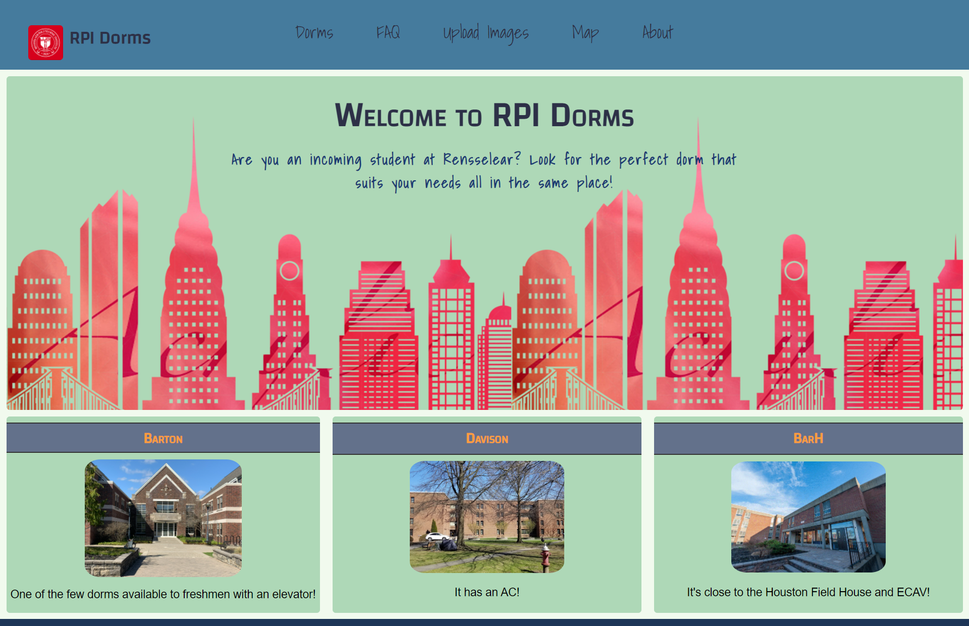
Main page

Slide 9
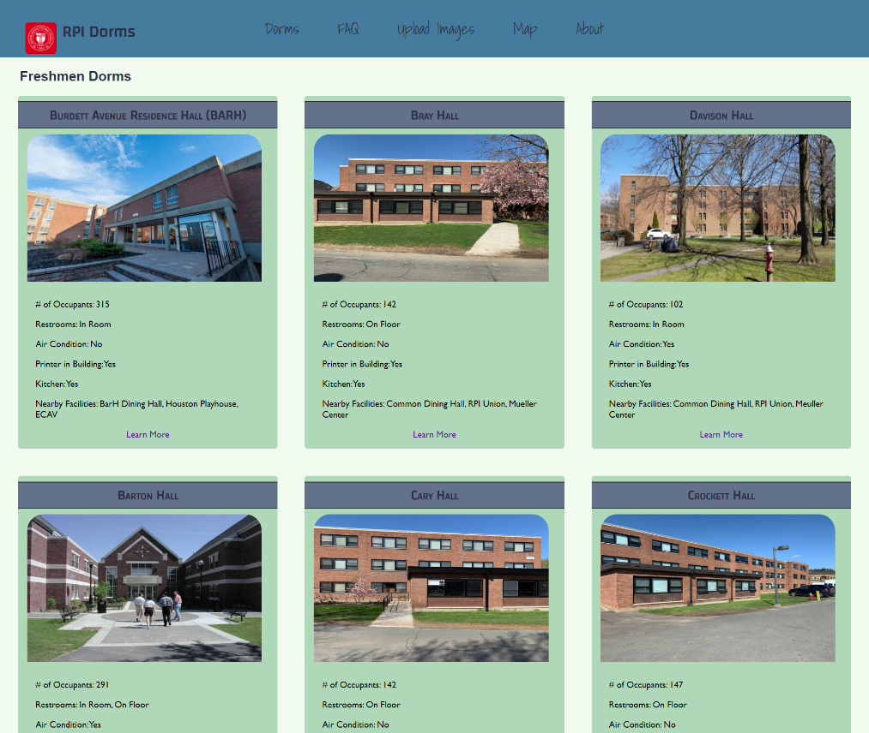
Dorms

Slide 10
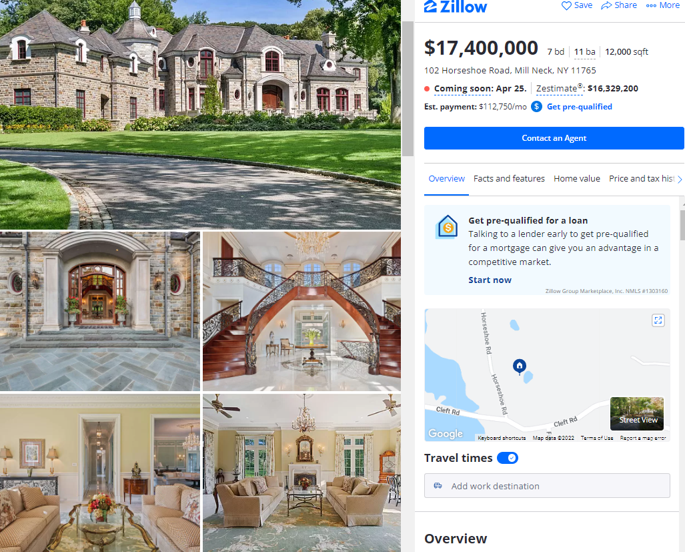
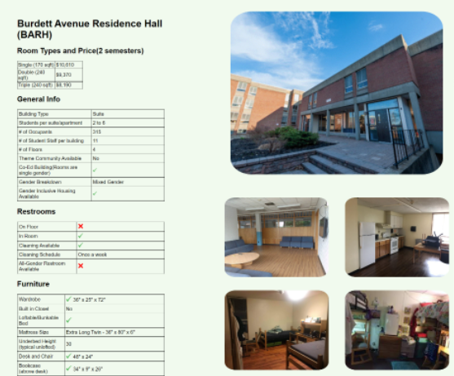
Specific Dorm page

Slide 11
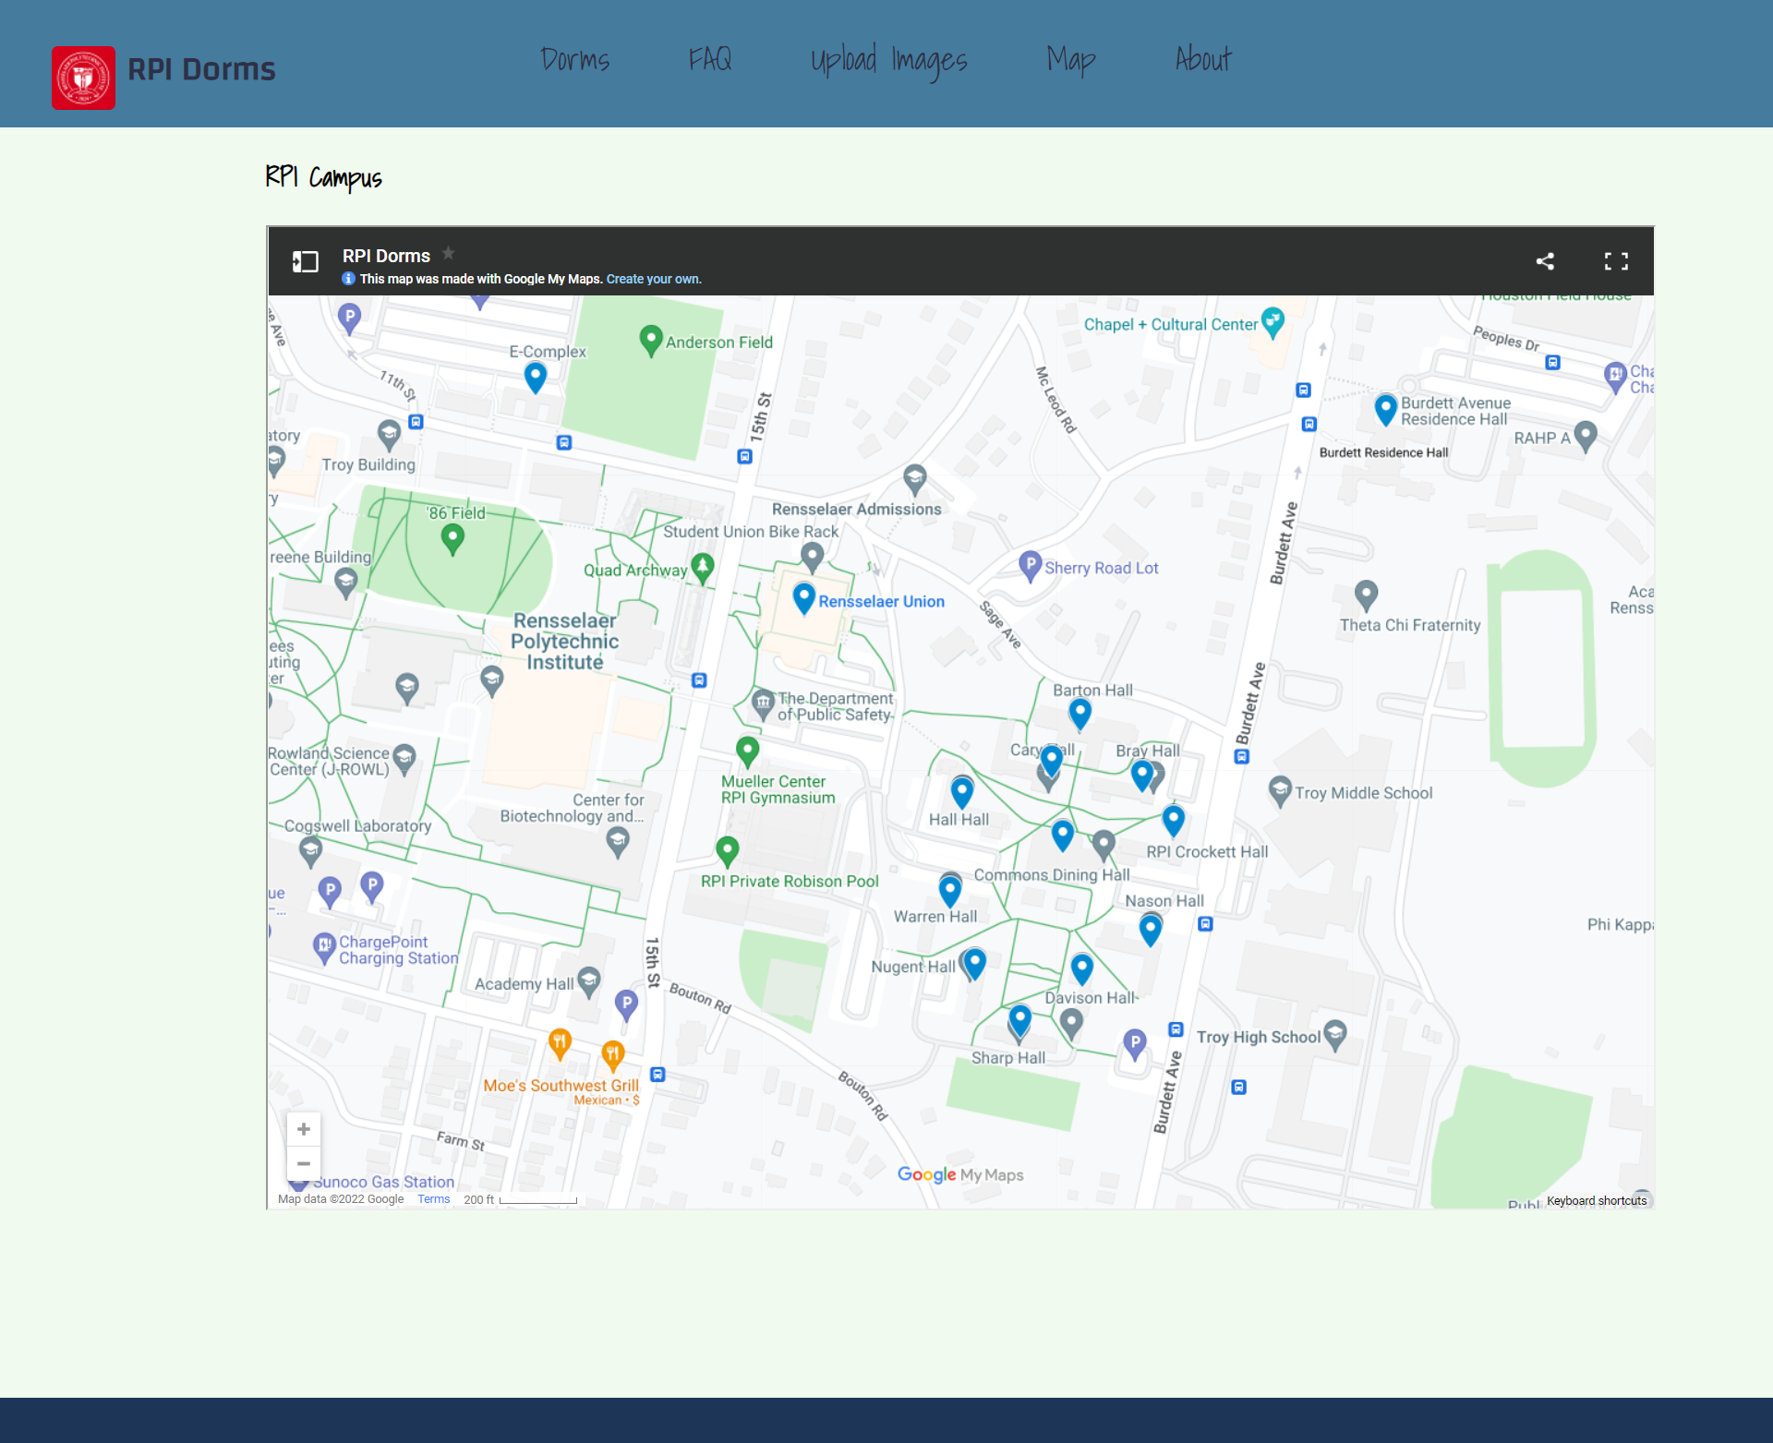
Map

Slide 12
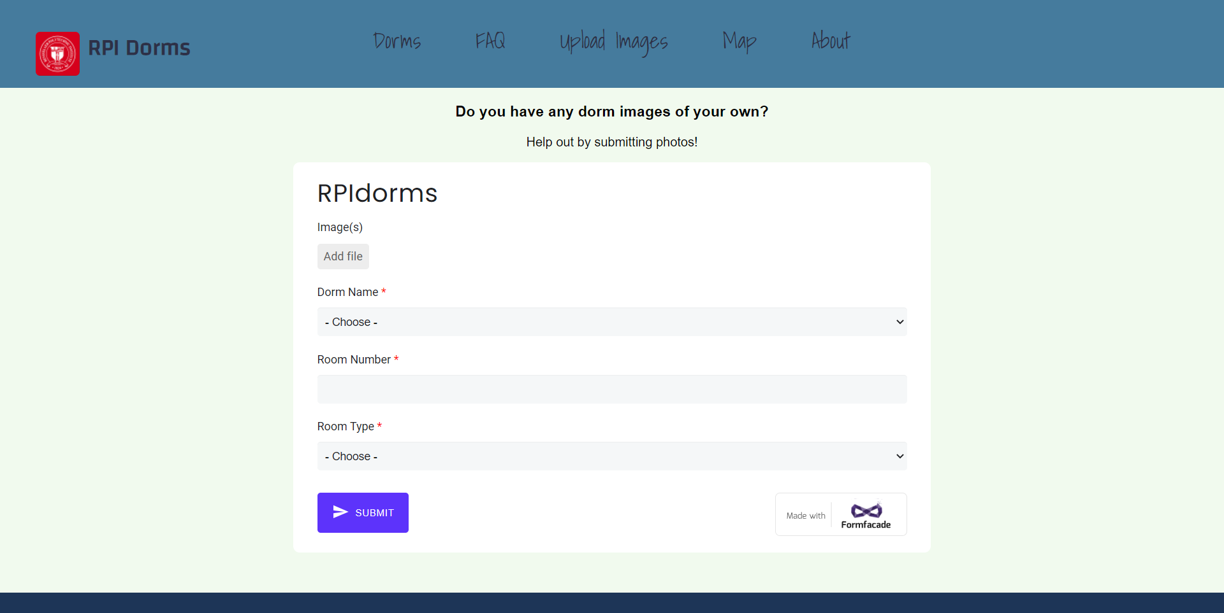
Upload Image

Slide 13
IA
https://octopus.do/wau4007fvi

Slide 14
02.
Demo
We will run through a quick demo of the website

Slide 15
Personas
Boblino
Boblina
From california, use to the hot temperatures
Loves to workout
Does not care about how
Many people he dorms with
But wants to find good roommates
Looking for dorms for her daughter
Allergies to animals runs in family
Is conscious about the cost of living
Freshman
Mom
18 years old
57 years old

Slide 16
03.
Results
Final Thoughts/Conclusions About The Project

Slide 17
Areas We Focused On
Area 1: HTML, CSS, and graphics for page layout and design
Area 3: Pull static data from a data file (JSON)

Slide 18
Challenges
Search bar
Forms

Slide 19
Questions or Comments?

